Slide 1

Process Mining Virtual Internship
by
Sree Nithya G
Roll No. 214G1A32A1
Department of Computer Science and Engineering (Data Science)
Srinivasa Ramanujan Institute of Technology
(Affiliated to JNTUA & Approved by AICTE) (Accredited by NAAC with ‘A’ Grade & Accredited by NBA (EEE, ECE & CSE)
Rotarypuram Village, B K Samudram Mandal, Ananthapuramu – 515701.
2023 - 2024

Slide 2

Contents
Course Objective
Introduction
Technology
Applications
Modules
Real Time applications
Learning outcomes
GitHub Link
Queries

Slide 3
Course Objectives
Apply Celonis for analyzing business processes, identifying inefficiencies.
Integrate data from various sources into Celonis for comprehensive analysis.
Create process visualizations in Celonis to show flows and performance.
Uncover root causes of process issues through process mining techniques.
Implement KPIs in Celonis to effectively measure and monitor performance.
Suggest process optimizations based on insights gained from Celonis.
Develop data cleaning skills for accurate process mining results.
Detect and address anomalies using Celonis for process improvement.
Communicate findings to stakeholders through reports and presentations.
Understand continuous improvement and apply it using Celonis.
Refine data cleaning techniques for improved Celonis analysis outcomes.
Employ Celonis to support decision-making through data-driven insights.

Slide 4
Introduction
Process mining is a technique for analyzing and visualizing real-life processes within organizations. It involves using data from various sources to gain insights into process functioning. Event logs and data trails from business operations are analyzed to understand processes.
Process mining reveals inefficiencies, bottlenecks, and areas for improvement. It provides a data-driven approach to making informed decisions and optimizing workflows. The technique is used to enhance operational efficiency and ensure compliance. Process mining is applied across various industries to drive continuous improvement.

Slide 5
Technology
Event Logs: Gathering data from event logs generated by IT systems and a applications.
Data Extraction: Extracting relevant data from various sources, like databases and log files.
Data Preprocessing: Cleaning, transforming, and structuring data for analysis.
Process Discovery: Automatically generating process models from event data.
Conformance Checking: Comparing process models with real event data to identify deviations.
Performance Analysis: Evaluating process performance using key metrics and indicators.

Slide 6
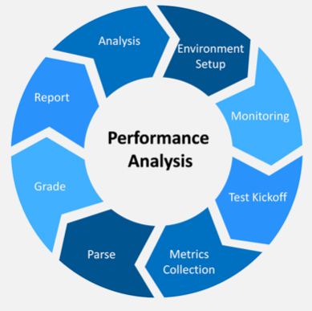
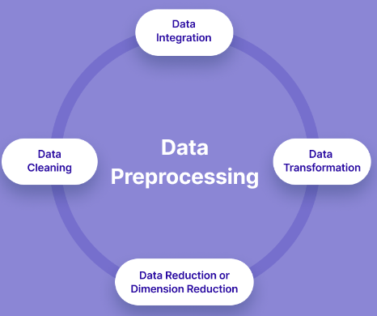
Contd…
Performance Analysis
Data Preprocessing

Slide 7
Cntd…
Process Visualization: Creating visual representations of process flows and activities.
Predictive Analysis: Using historical data to predict future process behavior.
Machine Learning: Employing ML algorithms to discover patterns and anomalies.
Data Mining: Extracting valuable insights from large sets of process data.
Business Intelligence: Utilizing BI tools for data analysis and decision-making.
Workflow Management: Automating and managing processes using workflow systems.

Slide 8
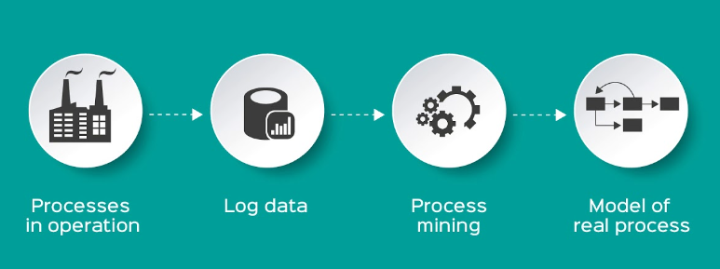
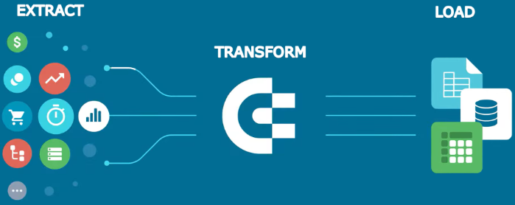
Contd…
Data Modelling
Data Transformation

Slide 9
Applications
Process Improvement: Identifying bottlenecks and inefficiencies to streamline processes.
Compliance Monitoring: Ensuring processes adhere to regulations and guidelines.
Root Cause Analysis: Uncovering reasons behind process breakdowns or delays.
Performance Evaluation: Measuring process efficiency and effectiveness with metrics.
Risk Management: Identifying potential risks and vulnerabilities in processes.
Customer Journey Analysis: Understanding customer interactions for better experiences.

Slide 10
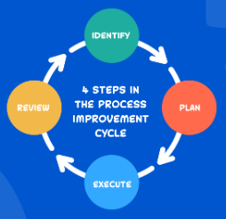
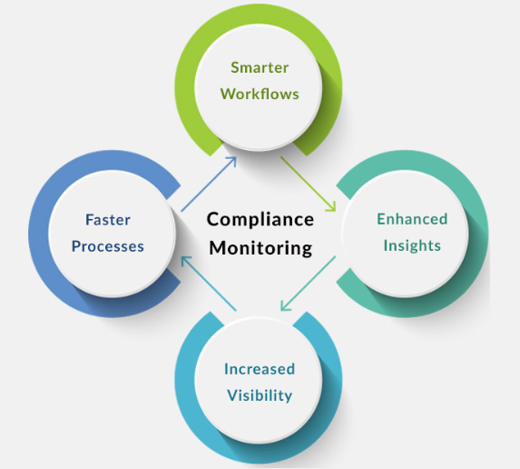
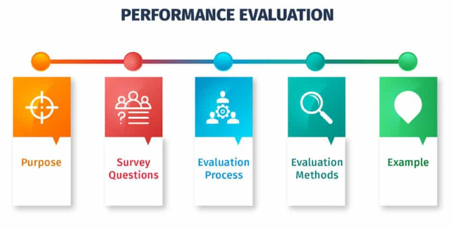
Contd…
Process Improvement
Compliance Monitoring
Performance Evaluation

Slide 11
Contd…
Supply Chain Optimization: Enhancing logistics and supply chain processes.
Fraud Detection: Identifying irregularities in financial and operational processes.
Healthcare Process Analysis: Improving patient care and resource allocation.
IT Service Management: Analyzing IT processes to enhance service delivery.
Manufacturing Efficiency: Optimizing production lines and manufacturing processes.
Invoice and Order Processing: Enhancing accuracy and speed of transactions.

Slide 12
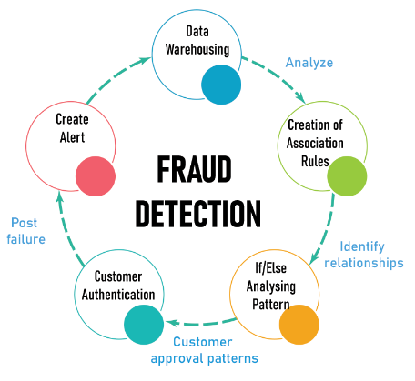
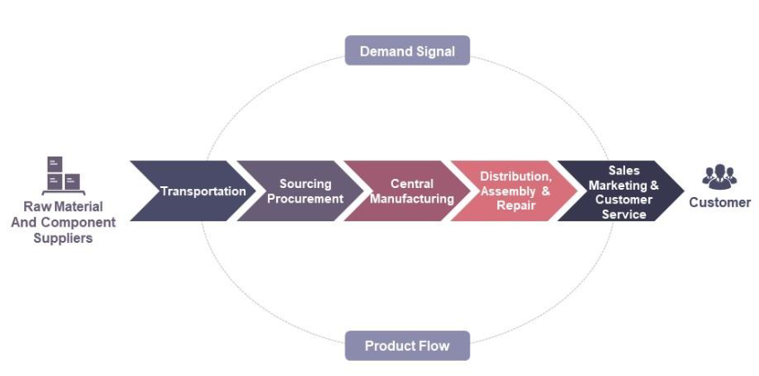
Contd…
Supply Chain Optimization
Fraud Detection

Slide 13
Modules
List of Modules:
Process Mining Life Cycle
Mechanism of Process Mining
Key Elements of Process Mining
Implementation Essentials
Gains from Process Mining
Initiating a Process Mining Project
Diverse Industry Applications
Practical Uses of Process Mining
Prime Process Mining Tools
Process Mining Software Providers

Slide 14
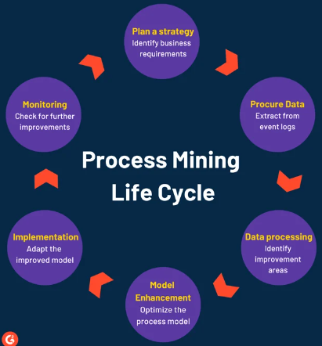
Process Mining Life Cycle

Slide 15
Mechanism of Process Mining
Data Collection: Gather event logs from systems.
Preprocessing: Clean, filter, and handle missing data.
Transformation: Structure logs into cases and activities.
Process Discovery: Generate process models from logs.
Conformance Checking: Compare models with actual logs.
Performance Analysis: Evaluate KPIs from event data.
Simulation: Test process changes in simulations.
Process Improvement: Optimize based on insights.
Visualization: Present results for decision-making.

Slide 16
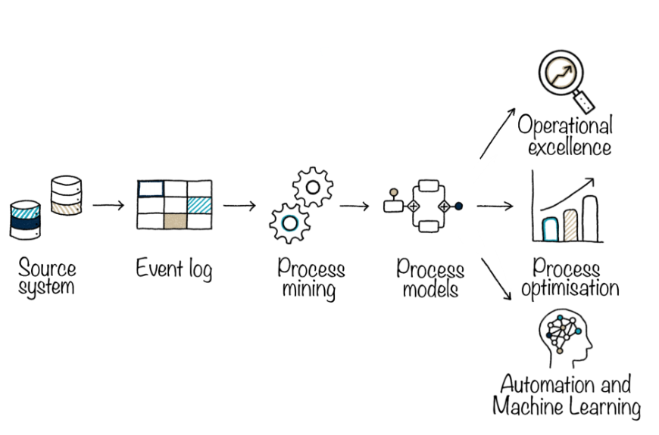
Key Elements of Process Mining

Slide 17
Implementation Essentials
Goal: Define clear objectives.
Data: Gather accurate logs.
Tools: Choose suitable software.
Preparation: Clean and prep data.
Mapping: Create process models.
Metrics: Pick key indicators.
Analysis: Identify issues.
Improvement: Make changes.
Documentation: Keep records.

Slide 18
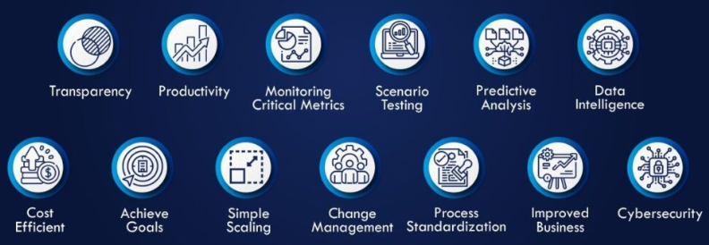
Gains from Process Mining

Slide 19
Practical Uses of Process Mining
Optimization: Improve efficiency and remove bottlenecks.
Compliance: Ensure adherence to regulations.
Root Cause Analysis: Identify reasons for variations.
Customer Experience: Enhance understanding of customer interactions.
Supply Chain: Streamline supply chain processes.
Fraud Detection: Detect unusual process patterns.
Healthcare Improvement: Optimize medical workflows.
IT Management: Monitor and improve IT processes.
Manufacturing: Optimize production processes.
Financial Operations: Enhance financial processes.
HR Efficiency: Streamline HR workflows.
Insurance Claims: Improve claims processing.
Logistics: Analyze and optimize logistics.

Slide 20
Any Queries?

Slide 21
Thank You!!!

